Slide 1
CEF 440: INTERNET PROGRAMMING(J2EE) AND MOBILE PROGRAMMING

Slide 2
INTRODUCTION
MAIN UML DIAGRAMS
CONTEXT DIAGRAM
TABLE OF CONTENTS
USECASE DIAGRAM
CLASS DIAGRAM
SEQUENCE DIAGRAM
STATE DIAGRAM
ACTIVITY DIAGRAM

Slide 3
INTRODUCTION
What is UML?
What is a UML Diagram?
Why use UML Diagrams?
Types of UML Diagrams

Slide 4
MAIN UML DIAGRAMS
Use case Diagram
Class Diagram
Sequence Diagram
State Diagram
Activity Diagram

Slide 5

CONTEXT DIAGRAM It shows how a system interacts with external entities such as people, organizations, or other systems.

Slide 6
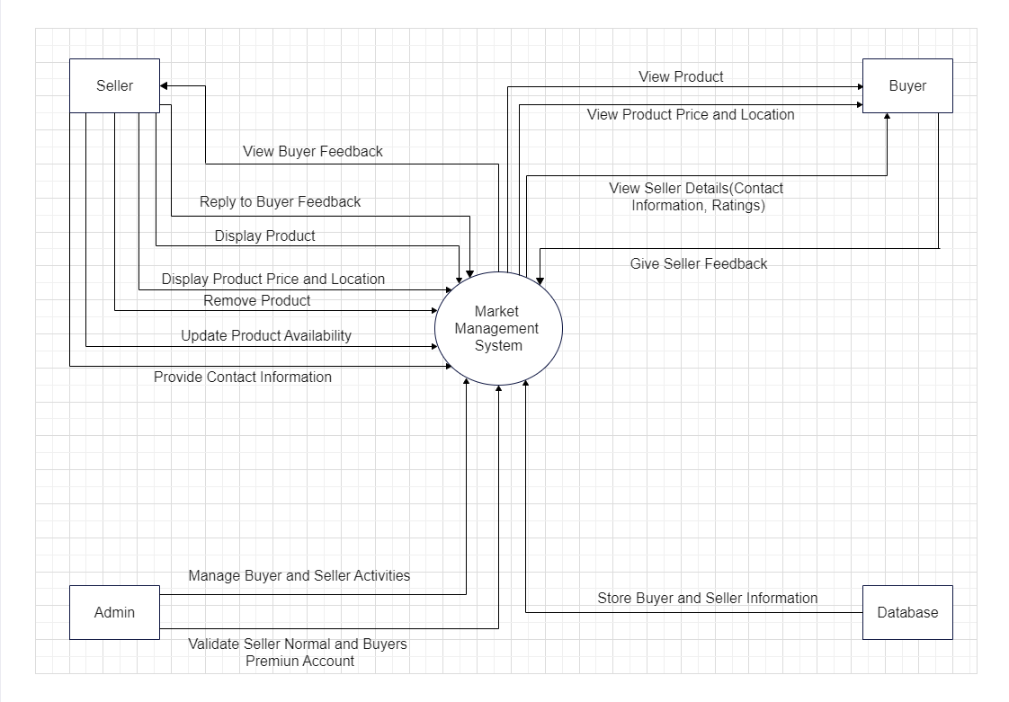

Slide 7

USECASE DIAGRAM
It helps us demonstrate the expected behavior of the system and defines and boundaries of the system and identify the main functionalities

Slide 8
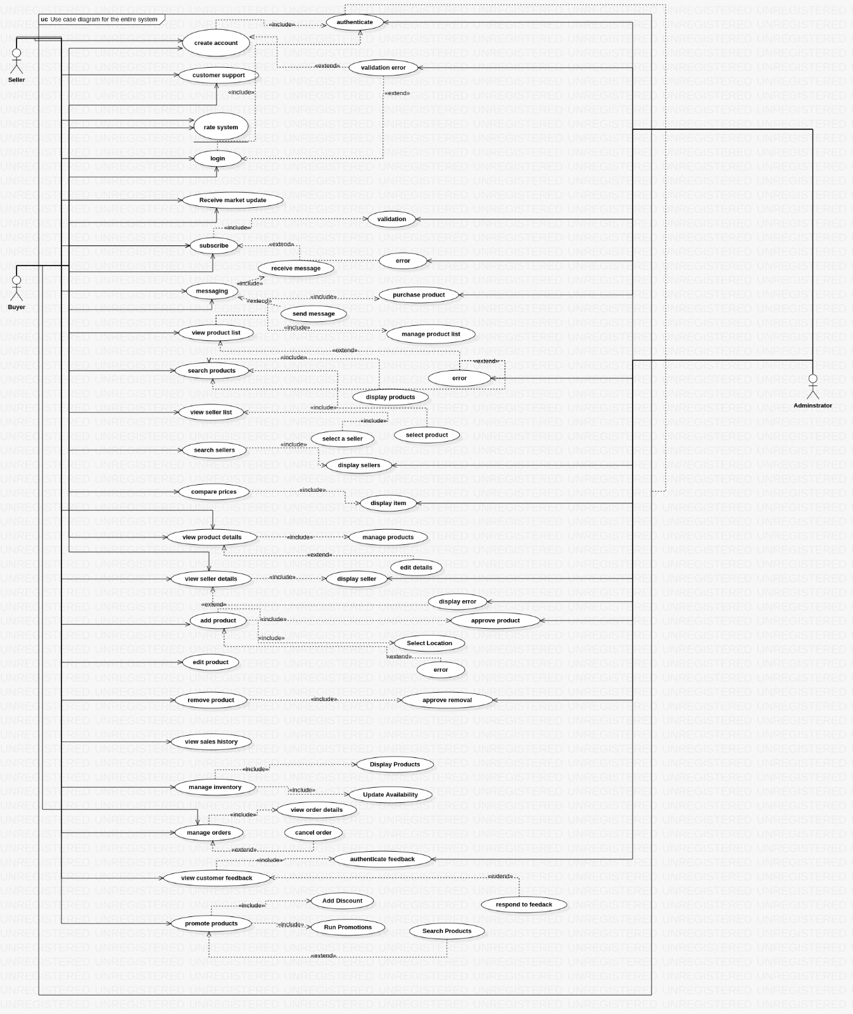

Slide 9
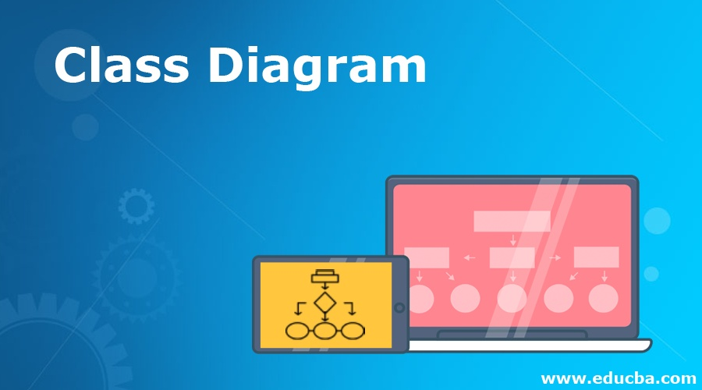
It shows the logical organization of the system and how data and behavior are encapsulated and related

Slide 10
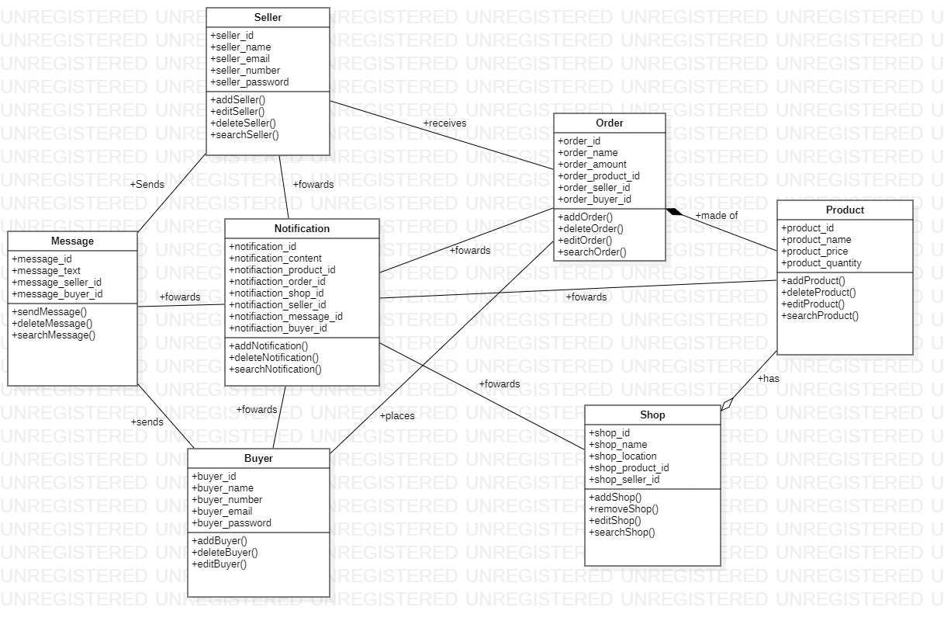

Slide 11

SEQUENCE DIAGRAM
This diagram illustrates the dynamic behavior of the system in terms of interactions between objects over time

Slide 12
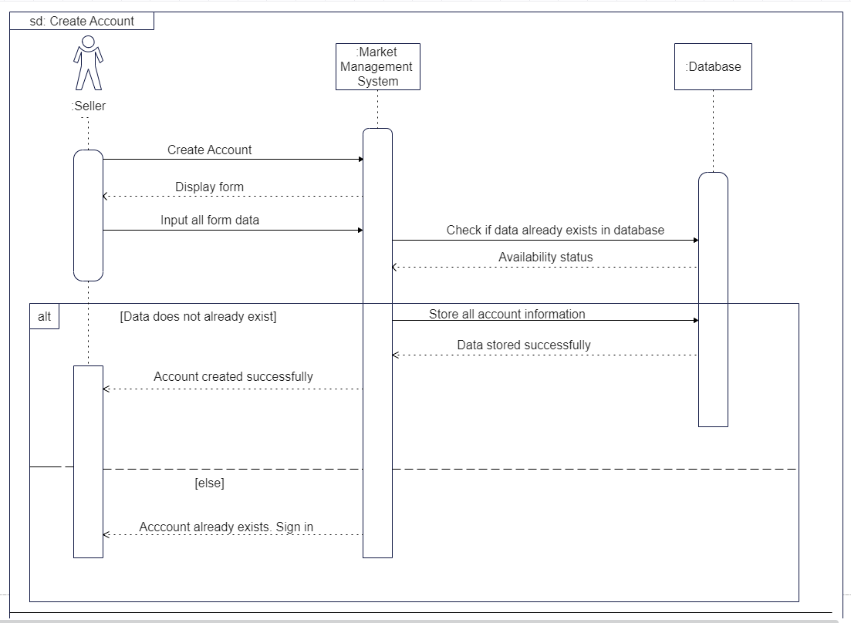
1. Create account

Slide 13
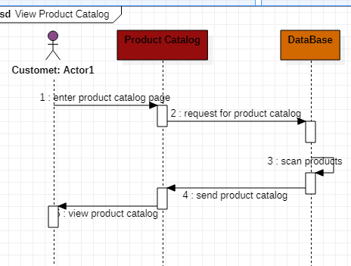
2. View Product List

Slide 14
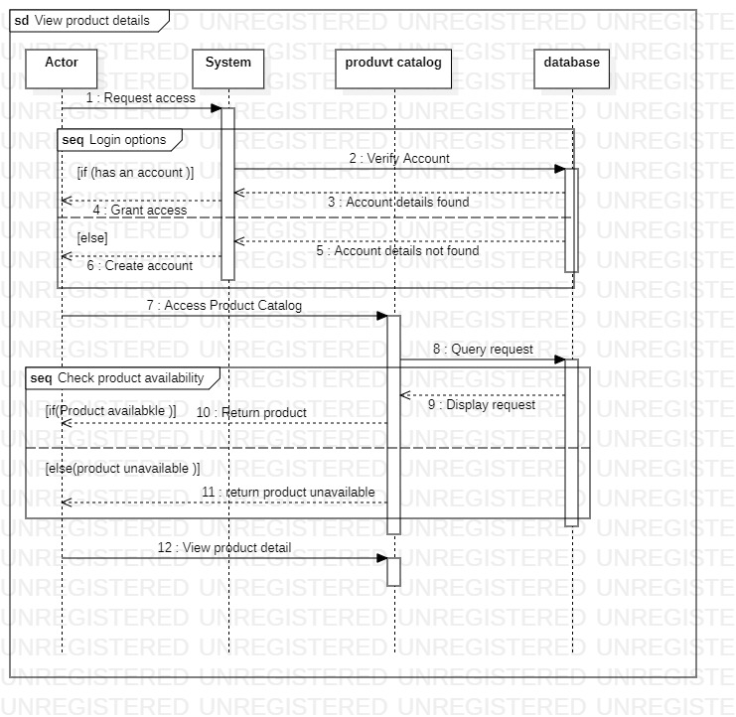
3. View product details

Slide 15

This diagram depicts the dynamic behavior of an object or a part of the system in terms of states, transitions, events, and actions

Slide 16
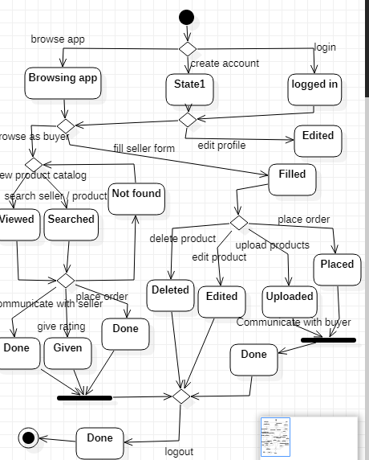

Slide 17
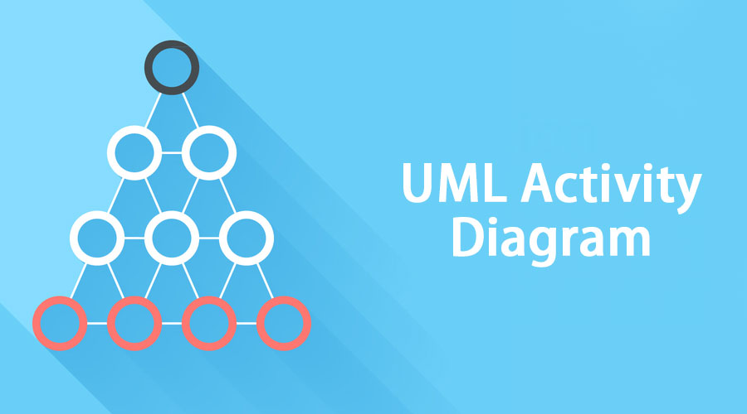
It shows how control and data flow through the system and how parallelism and synchronization are handled

